Slide 1

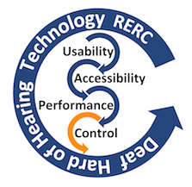
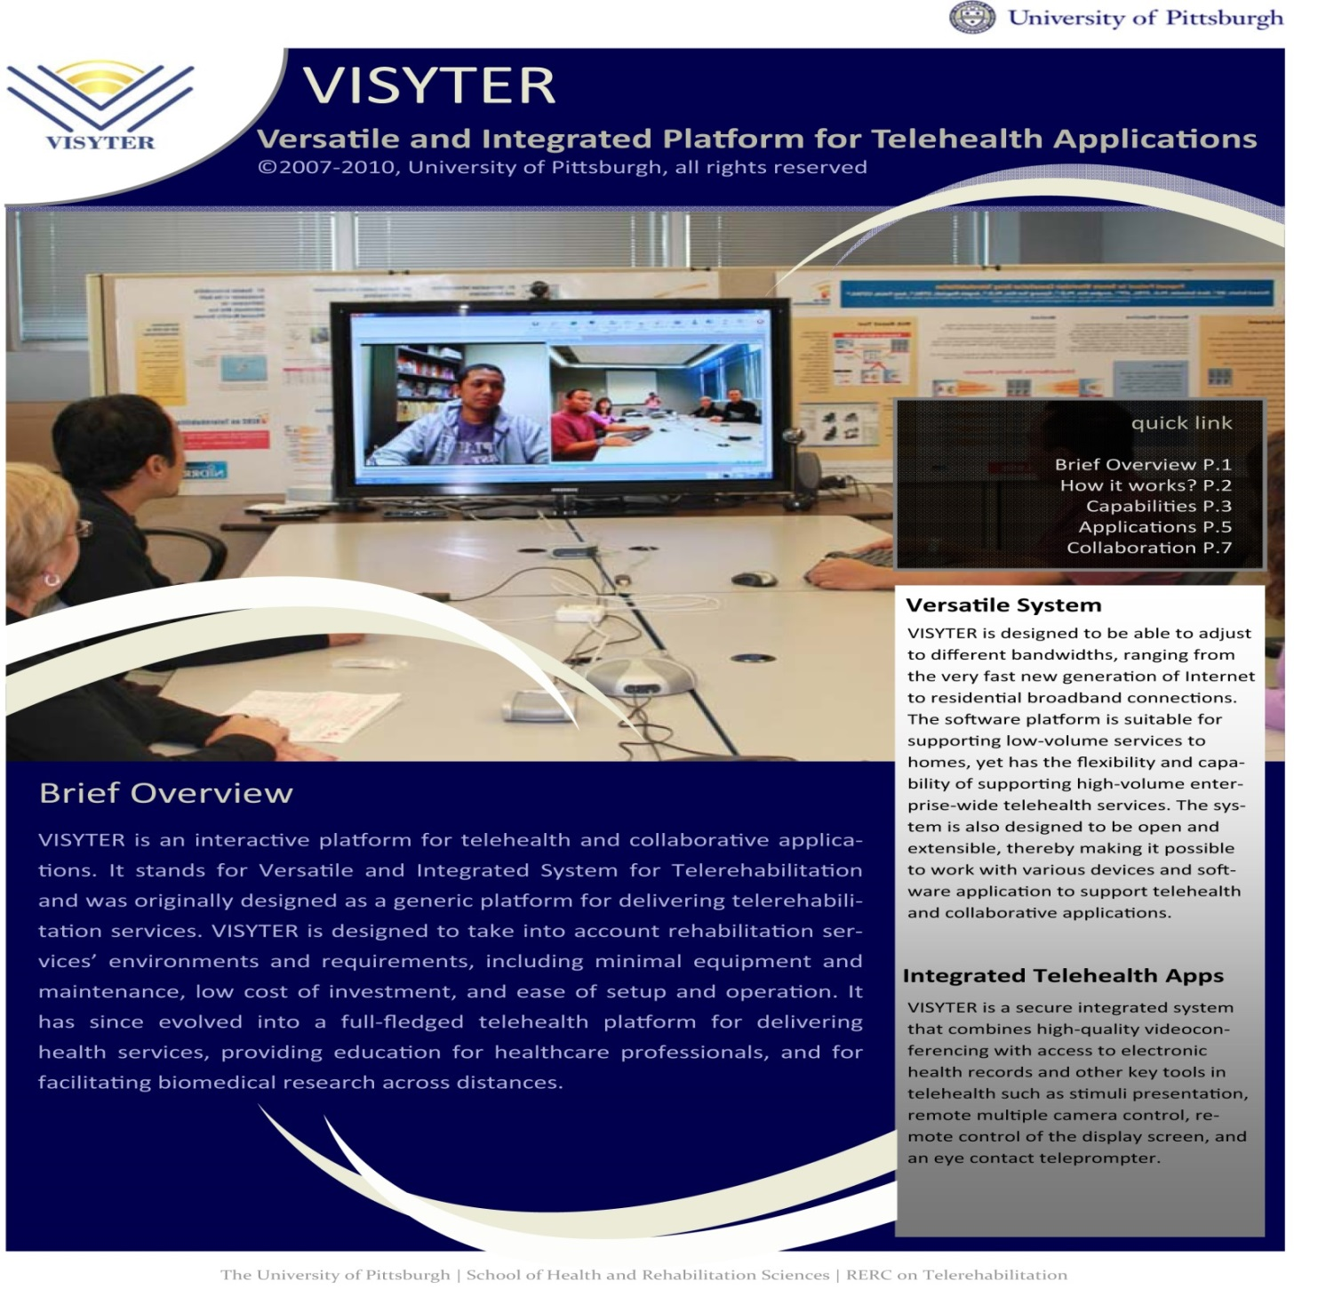
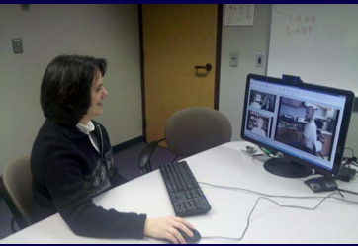
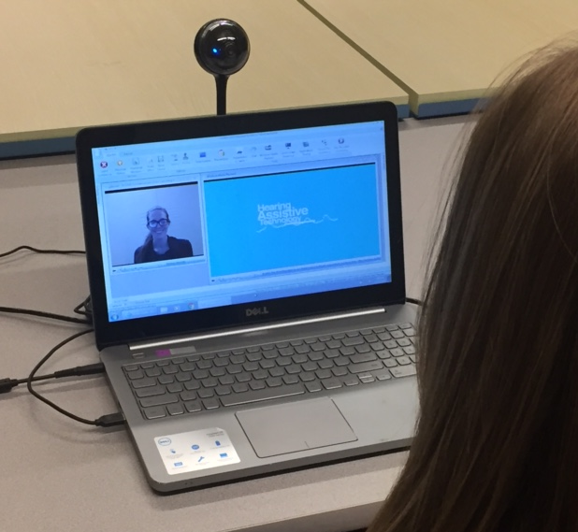
Telehealth Delivery of Aural Rehabilitation: A Clinical Trial for Adult Cochlear Implant Users
Claire Bernstein¹, Diane Brewer²,
Cassandra Bosworth ⁵, Karah Gottschalk³, Anne Olson³, Keena Seward⁴, Gina Stillitano⁶, and Sarah Sydlowski⁶
¹Gallaudet University , ²George Washington University. ³University of Kentucky Health Sciences, ⁴University of Maryland, ⁵Columbia University, ⁶Cleveland Clinic
Background
Telehealth Platform
Preliminary Results
Increasing numbers of adults who receive cochlear implants achieve high levels of speech perception (Gandolfi et al., 2014) and quality of life (Capretta and Moberly, 2016). For those who do not achieve such high levels of success, audiologic rehabilitation (AR) therapy may be warranted. There is evidence that brain plasticity through the lifespan could allow a listener to learn to code new auditory information provided by cochlear implantation (Fallon et al, 2008). Short-term AR intervention may be able to take advantage of neuroplasticity to further improve the CI benefits.
Prior randomized controlled trial (RCT) showed statistically significant improvement in speech recognition and psychosocial measures for an AR treatment group as compared to a control group (Bernstein, Brewer 2017). While the study demonstrates the potential benefits of short-term AR, there remain problems of access to service due to limited availability of clinicians, mobility and travel issues or time away from work. The present study was designed to evaluate the effectiveness of an AR program delivered via a telehealth platform.
Speech Recognition Measures
Versatile System
VISYTER is designed to be able to adjust to different bandwidths, ranging from the very fast new generation of Internet to residential broadband connections. The software platform is suitable for supporting low-volume services to homes, yet has the flexibility and capability of supporting high-volume enterprise-wide Telehealth services. The system is also designed to be open and extensible, thereby making it possible to work with various devices and software application to support Telehealth and collaborative applications.
Integrated Telehealth Apps
VISYTER is a secure integrated system that combines high-quality videoconferencing with access to electronic health records and other key tools in Telehealth such as stimuli presentation, remote multiple camera control, remote control of the display screen, and an eye contact teleprompter.
Audiologist at Clinic
Participant at Home
Purpose
The study was designed to evaluate the effectiveness of an Aural Rehabilitation (AR) training protocol to improve outcomes for adult CI users via telerehabilitation in a randomized controlled trial (RCT)
Procedures
Participant Characteristics
Twenty four post-lingually deafened adult cochlear implant users 18 or older
Between three months and three years post-activation of the cochlear implant
No aural rehabilitation therapy post-implantation
Speech tracking rate of at least 20 words per minute
Sentence recognition scores (CasperSent, AZBio) between 10% and 85%
English speaking
Normal cognitive function (Six Item Screener Callahan et al., (2002)
Research Design
Randomization Group: Aural Rehabilitation Group or
Active Control Group
Assessments: Three Sessions: Pre, Post -1 week, and
2 months post
Treatment: Six 90-minute individual sessions (see below)
Treatment Protocol
Outcome Measures
Area | Measure
Speech Recognition | CasperSent (Boothroyd, 1987) AzBio Sentence Test (Spahr et al., 2012)
Psychosocial Measures | Hearing Handicap Inventory (HHI) (Ventry and Weinstein, 1982; Newman et al.,1990) Client Oriented Scale of Improvement (COSI) (Dillon et al., 1997) Glasgow Benefit Inventory (GBI) (Robinson et al., 1996)
Discussion
The first four participants were randomly assigned to the AR treatment group. These preliminary results with short-term AR training showed major improvements in speech intelligibility, as measured on an independent tests of sentence recognition. After 6 weeks of AR training there was an average increase of +15% on AzBio and + 16% on CasperSent two months following treatment.
Gains in personal communication goals, as determined by the COSI technique, were reported following the AR training program. Further, large reduction in hearing handicap and benefit on self-assessed communication function were found using the HHI with positive changes on the social, general and overall GBI scores.
Psychosocial Measures
*Lower Score is Better
Demographics
Summary
Aural Rehabilitation Group (AR)
Informational Counseling CI Orientation and Training Equipment and programs Assistive listening devices Telephone use Communication Strategies Training Auditory Training Sentence identification Vowel & consonant contrasts KTH Speech Tracking
Control Group (CT)
Cognitive Training Exercises Choice of 3 Activities: Crossword Puzzles Spot the Difference Ken-Ken Word Searches Sudoku
Participant | Age | Sex | Device | Etiology | Time Post-Activation | Duration of Profound HL
AR01 | 51 | M | Cochlear Kanso | Progressive, unknown | 6 months | 1 year
AR02 | 25 | F | Med-El | Unknown | 2 years | 20 years
AR03 | 87 | M | Cochlear Nucleus 7 | Noise-induced | 4 months | 15 years
AR04 | 74 | M | AB Naida Q90 | Familial | 2 years | 12 years
Telehealth AR has the potential to
Improve outcomes for speech recognition
Reduce hearing handicap
Improve communication goals
Overcome limitations preventing AR service delivery
Acknowledgements
Funding for this research was also provided by Grant # 90RE5020 from the National Institute on Disability, Independent Living, and Rehabilitation Research (NIDILRR), which is a Center within the Administration for Community Living (ACL), Department of Health and Human Services (HHS).

